Slide 1

Thomson Reuters is proud to be your partner at the LehighHacks. Here’s what you need to know to be able to use Thomson Reuters data and API in your project. Good luck!!!

Slide 2
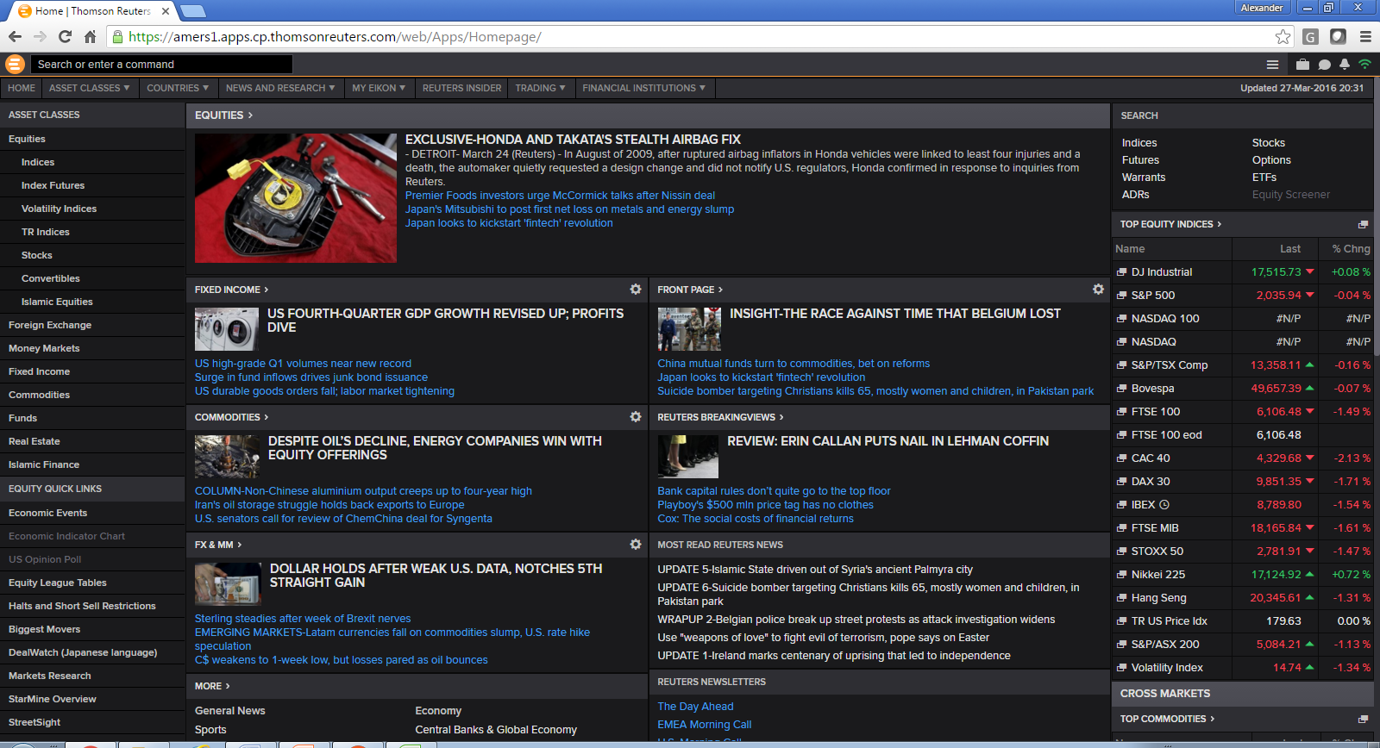
http://eikon.thomsonreuters.com/login

Slide 3

Timeseries Web Service API
Content :
Intraday and Interday Price Series Histories
You Define :
Which Instruments ➔ RIC Concept
Which date range ➔ Start date in the format (YYYY-MM-DDTHH:mm:ssZ)
End date in the format (YYYY-MM-DDTHH:mm:ssZ)
Which Interval ➔ ”Tick, ”Minute”, “Hour”, “Daily”, “Weekly”, “Monthly” or ” Quarterly”
Fields is a string array that must include “TIMESTAMP,” and then either “OPEN”, “HIGH”, “LOW”, “CLOSE” and optionally “VOLUME”, or “VALUE”.
https://dev.api.thomsonreuters.com/eikon/v1/timeseries?X-TR-API-APP-ID=YOURAPIKEY
3) API returns JSON results
{
"timeseriesData": [
{
"ric": "IBM.N",
"dataPoints": [
[
"2015-12-01T15:00:00Z",
139.68,
141.09,
139.65,
140.71,
162258
],
[
"2015-12-01T16:00:00Z",
140.73,
140.76,
139.65,
140,
83568
], +++
1) Create well formed JSON Query
2) POST to timeseries ENDPOINT
{
"rics": ["IBM.N"],
"interval": "hour",
"startdate": "2015-12-01T00:00:00Z",
"enddate": "2015-12-07T23:59:59Z",
"fields":
["TIMESTAMP","OPEN","HIGH","LOW","CLOSE","VOLUME"]
}

Slide 4
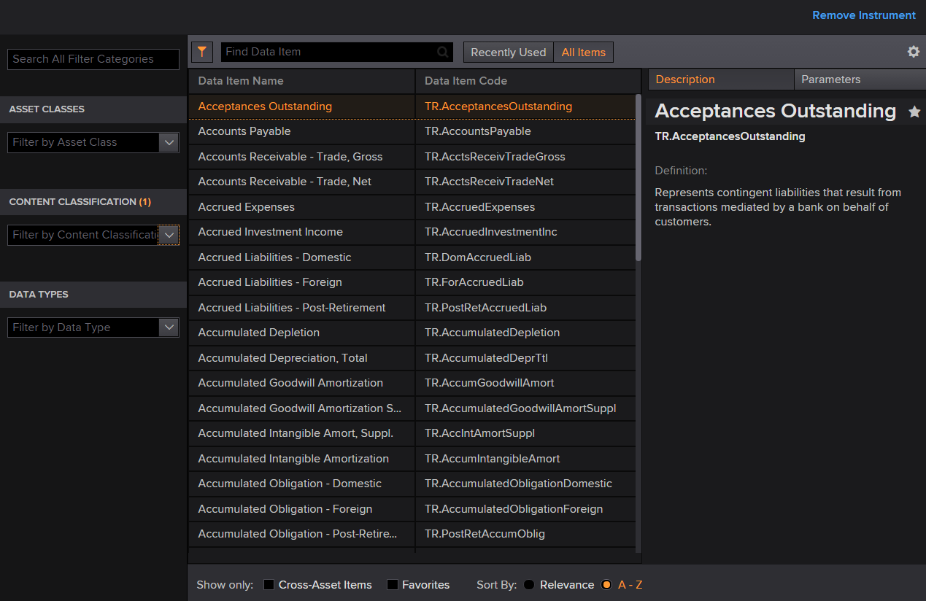
DataGrid Web Service API
Content :
Income Statements (313 Items),
Balance Sheet (342 Items) ++
Period End Ratios (1461 Items)++
I/B/E/S Estimates
Credit Ratings (30 Items)++
Environmental (114 Items)++
Corporate Actions (154 Items)++
..... Lots more!
https://amers1.views.cp.thomsonreuters.com/Apps/DataItemBrowser/
More fields, more parameters ➔ Increased complexity
Use our Data Item Browser to explore data sets and fields that are available
Filter by Content Type and list of available fields will be displayed – along with description as well as parameters
Once you have made a note of the field names you want to retrieve data for – along with their appropriate parameters – you can create a JSON request payload – which you will then send to the Endpoint

Slide 5
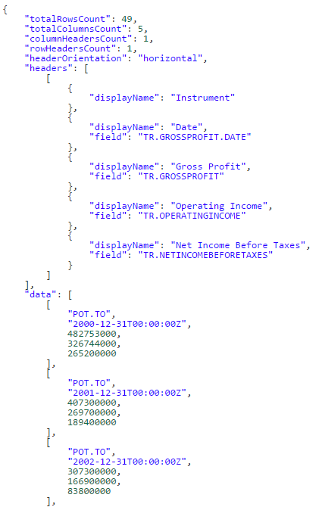
DataGrid Web Service API
1) Create well formed JSON Query
https://dev.api.thomsonreuters.com/eikon/v1/datagrid?X-TR-API-APP-ID=YOURAPIKEY
3) API returns JSON results
{
"instruments": [ "POT.TO", "GOOGL.O", "MSFT.O" ],
"fields":[
{"name": "TR.GrossProfit.date"},
{"name": "TR.GrossProfit"},
{"name": "TR.OperatingIncome"},
{"name": "TR.NetIncomeBeforeTaxes"}],
"parameters": {"Period":"FY-15","Period":"FY0"}
}
Add your Instrument RICs here
Add the fields you want data for here
Add the required parameters here
2) POST JSON Request payload to DataGrid ENDPOINT

